Slide 1
Analyzing the Impact of a Large Diversity Dataset on Models Predicting Quantum Mechanical Properties
Yuelin Shen
Mentor: Justin Overhulse, Ph.D., Chloe Thangavelu, Ph.D.
January 31, 2024

Slide 2

Yuelin Shen
ATOM Trainee
My Experience
Lions Assurance Financials - Quantitative Analyst Intern
FrieslandCampina - Data Analyst Intern
Education
Columbia University - MS, Operation Research
UC Santa Barbara - BS, Financial Mathematics,
BA, Economics
Keywords
Volleyball, hiking
ys3785@columbia.edu

Slide 3
Background

Slide 4
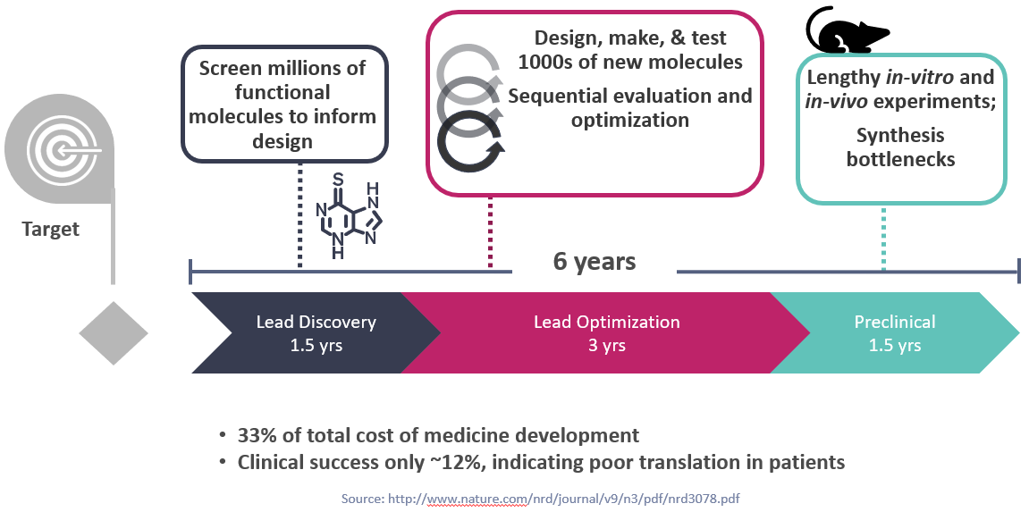
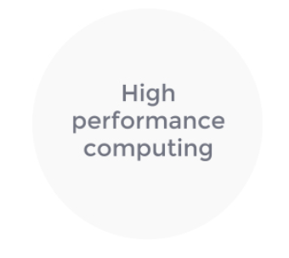
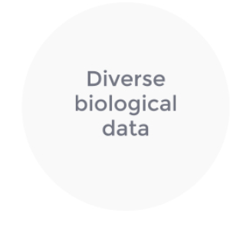
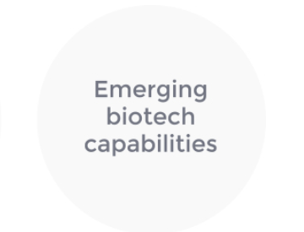
Challenge, Goal & Process

Slide 5
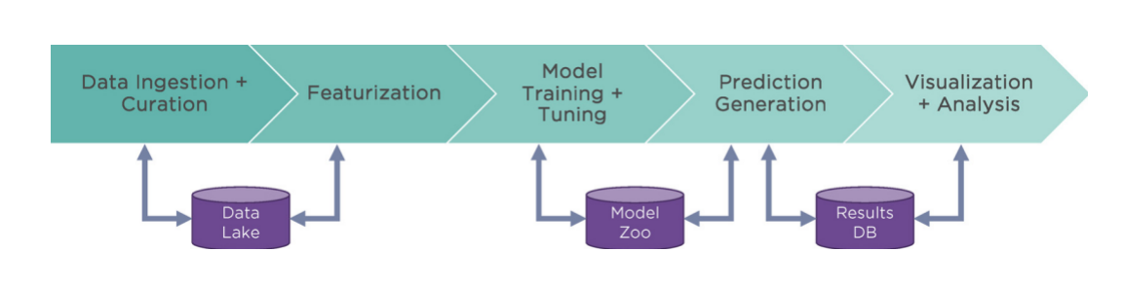
ATOM Modeling PipeLine (AMPL)
Notes:
Data curation : Generation of RDKit molecular SMILES structures; Processing of qualified or censored data processing; Curation of activity and property values
Featurization: Extended connectivity fingerprints (ECFP); Graph convolution latent vectors from DeepChem; Chemical descriptors from Mordred package; Descriptors generated by MOE (requires MOE license)
Model : Test set selection; Cross-validation; Uncertainty quantification; Hyperparameter optimization
Prediction : scikit-learn random forest models; XGBoost models; Fully connected neural networks; Graph convolution models (DeepChem)
Visualization and analysis: UMAP; Chemical diversity analysis

Slide 6
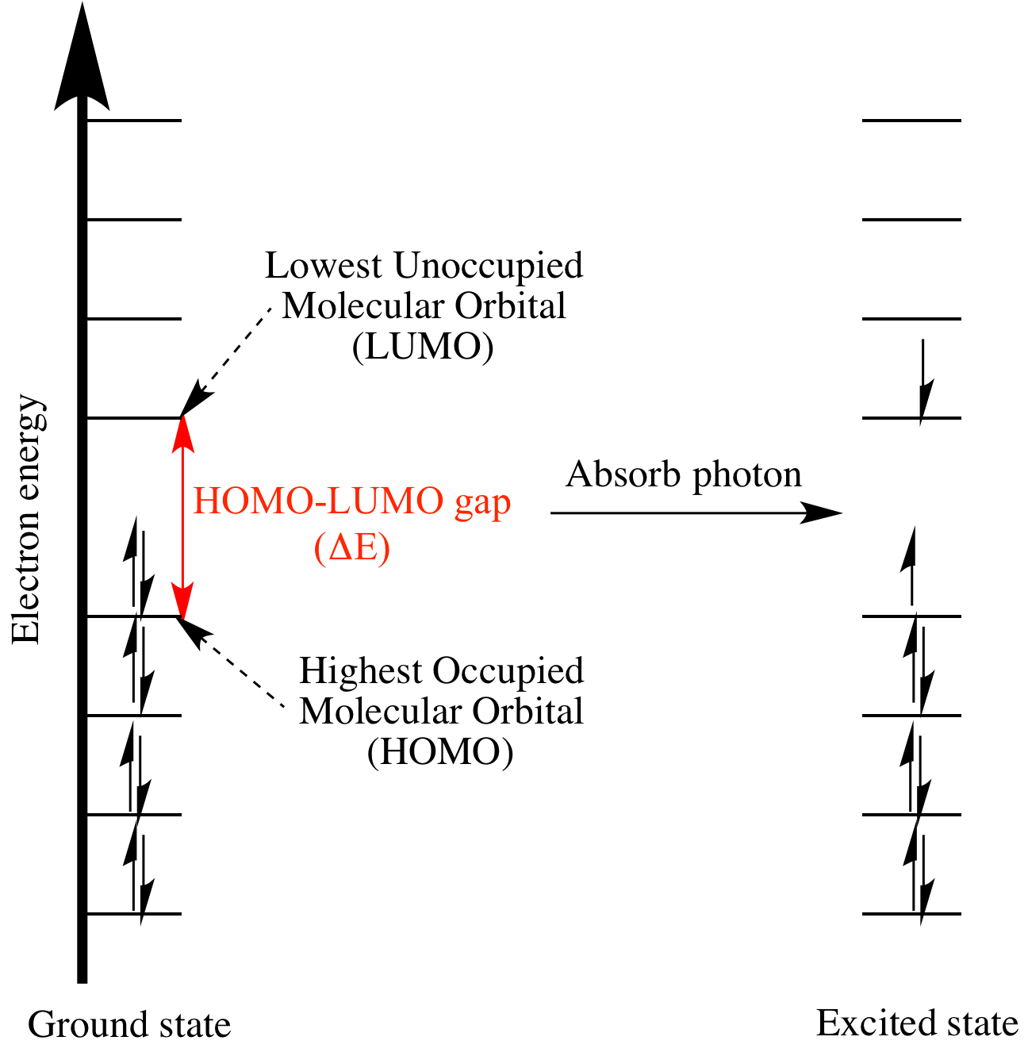
HOMO-LUMO Gap
HOMO: highest occupied molecular orbital
LUMO: lowest unoccupied molecular orbital
Larger gaps required more energy to excite an electron
Less reactive, more stable

Slide 7
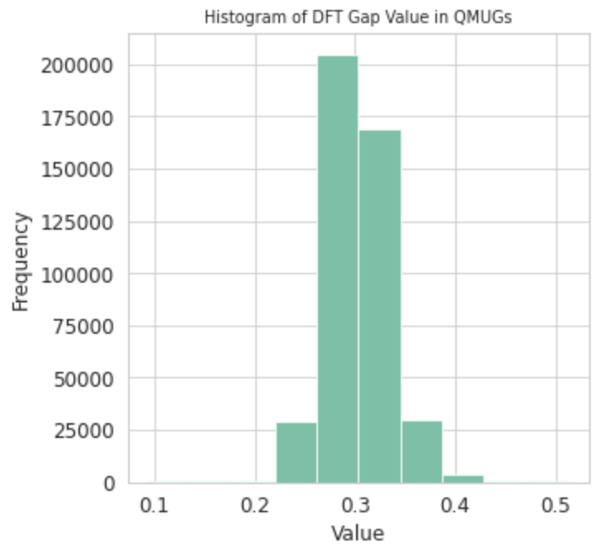
Overview of QMUGS
Full Name of the dataset
Quantum Mechanical Properties of Drug-like Molecules
Size of the dataset
Stores 1,992,984 chemical compounds in total.
The dataset has 67 characteristics (compound id, smiles, atoms, rings, gap values)
Notes:
Add visualizations of compounds

Slide 8
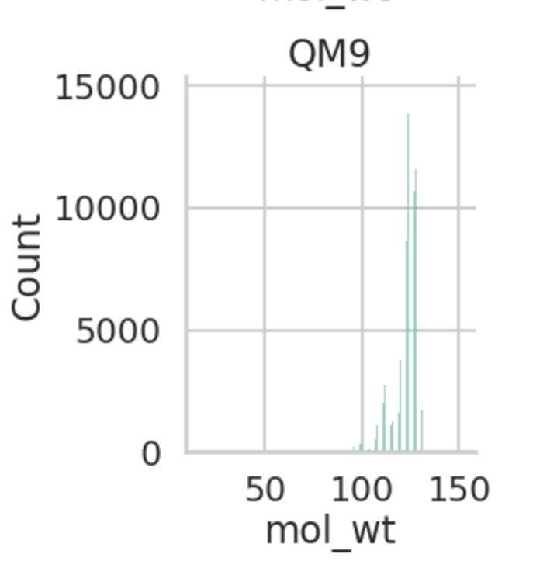
Distribution of Molecular Weight and details of QM9
Composed of over 134,000 small organic molecules
Contain carbon, hydrogen, oxygen, nitrogen and/or fluorine
B3LYP/6-31G(2df,p) level of quantum properties
Drug-like compounds
Figure created previously by students, and table is from QMugs paper.
Dataset | Unique compounds | Total conformations | Heavy atoms max (mean) | Method
QM9 | 133,885 | 133,885 | 9 (8.8) | B3LYP/6–31 G(2df,p)
QMugs | 665,911 | 1,992,984 | 100 (30.6) | GFN2-xTB + ωB97X-D/def2-SVP

Slide 9
Overview of QMUGS - Continued
Distribution of Specific Valuable Characteristics - (Next Slide)
Density Functional Theory (DFT) Gap Value
Heavy Atom (HA) Count
Ring Count
Molecular Weight (M/W)

Slide 10
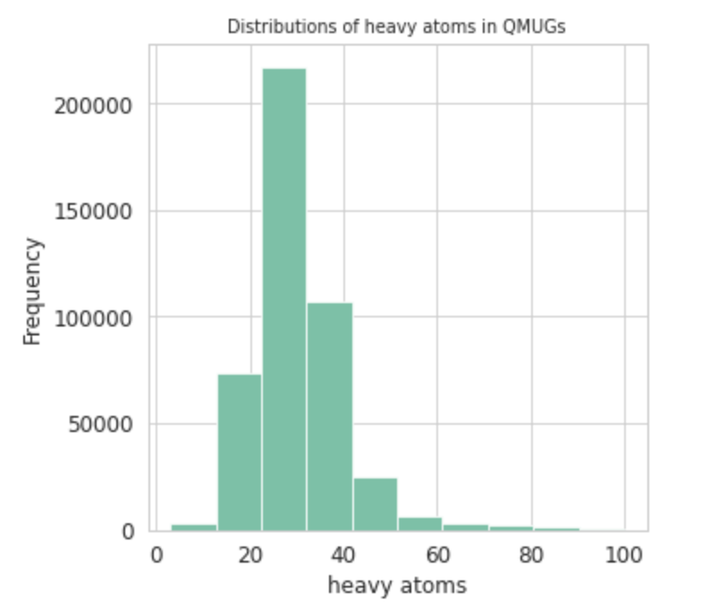
Overview of QMUGS - Continued
DFT Gap Value (Eh) Heavy atoms Count

Slide 11
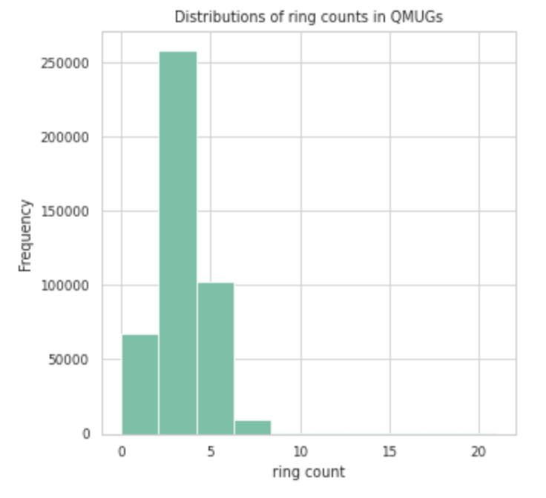
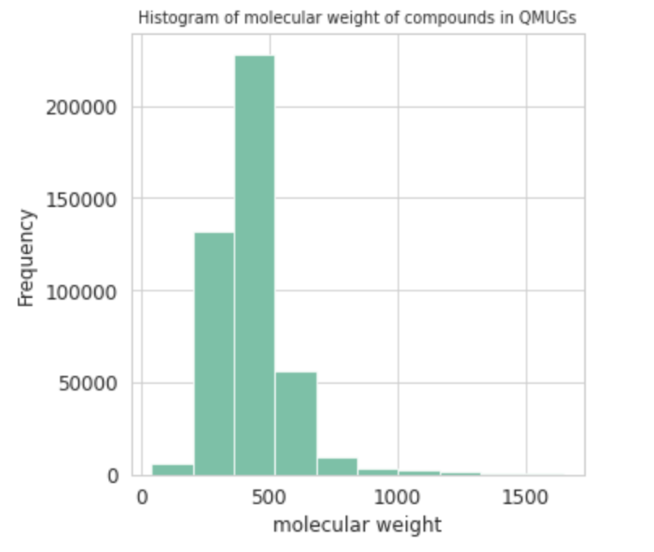
Overview of QMUGS - Continued
Ring Count Molecular Weight

Slide 12
Theory behind choosing Ring count, HA count and M/W
Generally, as number of conjugated rings increases, band gap decreases
Trend seen with our results
https://doi.org/10.1007/s00894-012-1671-1
As compounds increase in size, generally the gap values decrease, which is why we chose heavy atom count and molecular weight.
This may not occur because of the introduction of ie. functional groups; in literature ring number has had the greatest effect on gap value
https://doi.org/10.3389/fmech.2021.744001

Slide 13
Objective

Slide 14
Objective
Determine how featurizer and splitting methods impact model performance
Examine which combination of featurizer and splitter in the model could yield highest prediction accuracy
Compare how accurately our models could predict DFT gap values of different functional groups

Slide 15
Methods

Slide 16
Overview
Introduction to models
Data curation & Exploration on DFT gap value and functional groups
Model training
Comparing model performance

Slide 17
Step 1
Introductions to Models

Slide 18
Step 1 : Model Splitters
Random split : divides the dataset into separate datasets randomly
Scaffold split : splits molecules based on their scaffold or core structure.
More in depth than random and less in depth like fingerprints.
Fingerprint split : splits molecules based on their fingerprint or unique
characteristics.
ensures that similar data points don't end up in both training and test sets
Regression models : predicts a continuous dependent variable using a linear relationship between independent variables.
Notes:
(ECFP) featureizer is a method used in cheminformatics to transform molecular structures into numerical representations that can be used for machine learning models. ECFP captures the chemical environment of each atom in a molecule up to a certain radius. It works by considering not just the atom itself but also its neighboring atoms and the bonds connecting them. This creates a unique, hashed fingerprint for each atom, which is then combined to form a fingerprint for the entire molecule. These fingerprints are binary vectors, typically of a fixed length, where each bit represents the presence or absence of certain substructures within the molecule.
Scaffold is between random & fingerprint

Slide 19
Step 1 : Model Featurizers
GraphConv (Graph Convolution) featurizer : processes molecular graphs to extract
learned features
enables accurate predictions of chemical properties and compound
classification
ECFP (Extended-Connectivity Fingerprints) featurizer : converts molecular
structures into a numerical representation
captures and encodes molecular structures into fingerprints by analyzing
atoms and their connections.
Six Models in total
Notes:
Split match each of featurizers. Total 6 models.

Slide 20
Step 2
Data Curation & Exploration

Slide 21
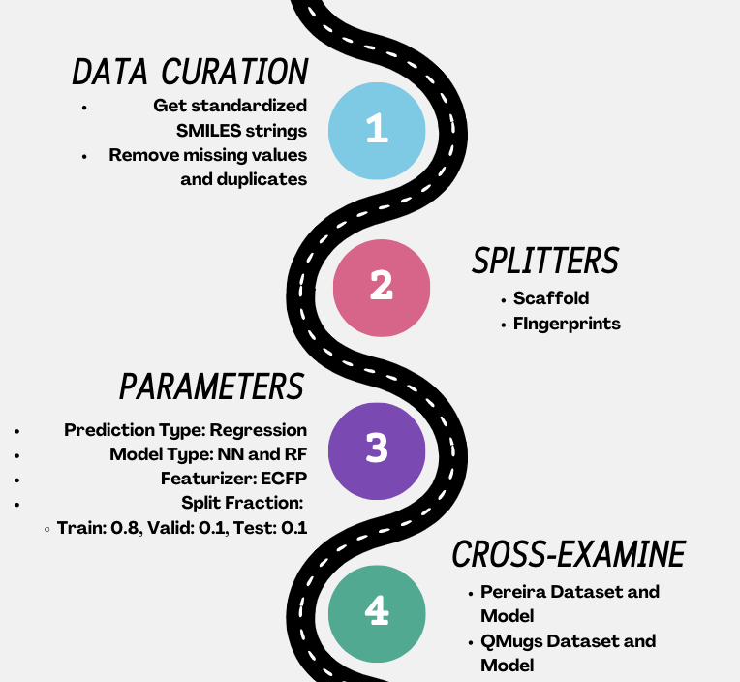
Step 2 : Data Curation
Generate compound id and rdkit_smiles string
Using RDKit, a toolkit for cheminformatics, to convert chemical structures into a standardized SMILES ( simplified molecular-input line-entry system) format, which ensures that the converted SMILES string is uniform and consistent even if the original data represents the same molecule in a different format or variant.
Remove duplicates and missing values
Aggregate compounds with same id
Check the curated dataset
437714 compounds now
Identify and compute functional groups in each compound
Generate compound id & rdkit smile str
Remove duplicates & missing value
Aggregate by taking the mean
Check & Save
Notes:
Add more information

Slide 22
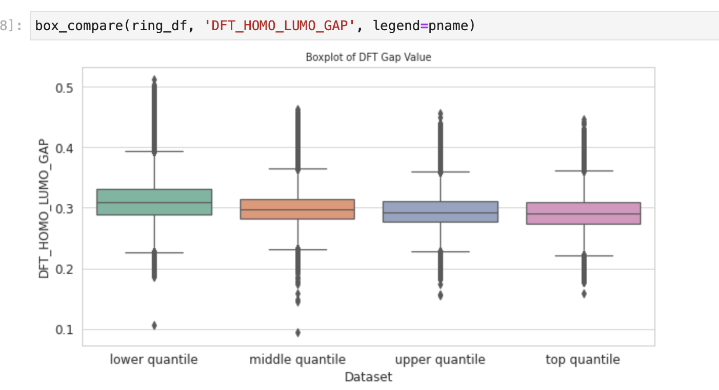
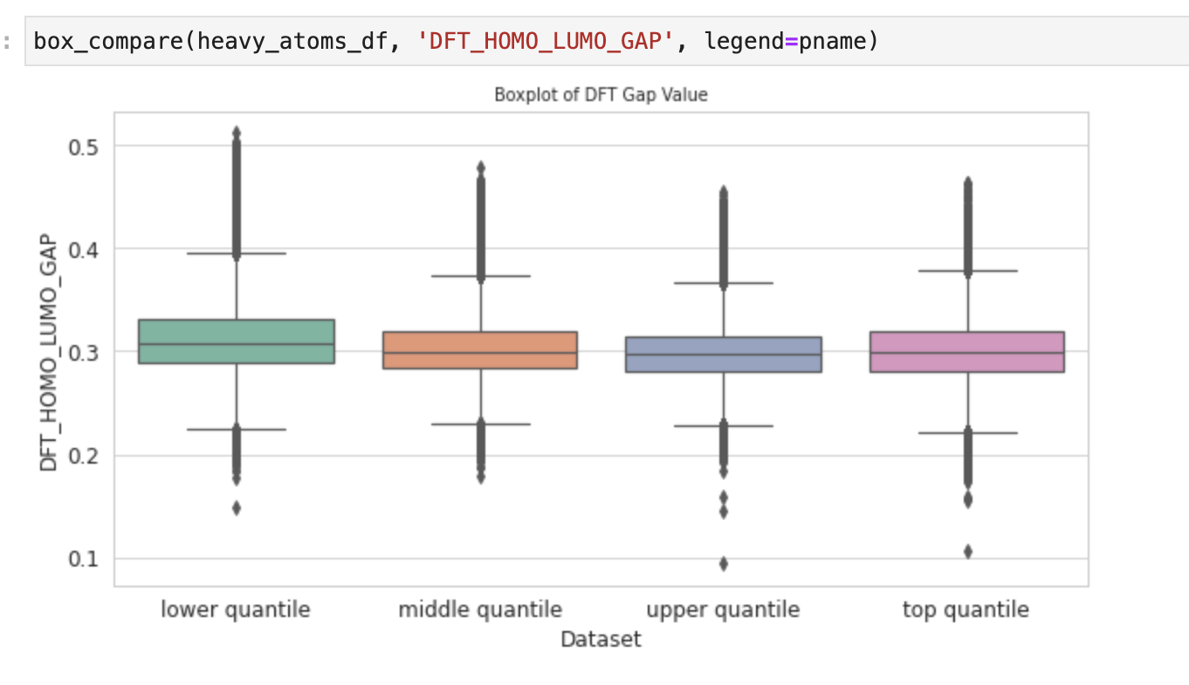
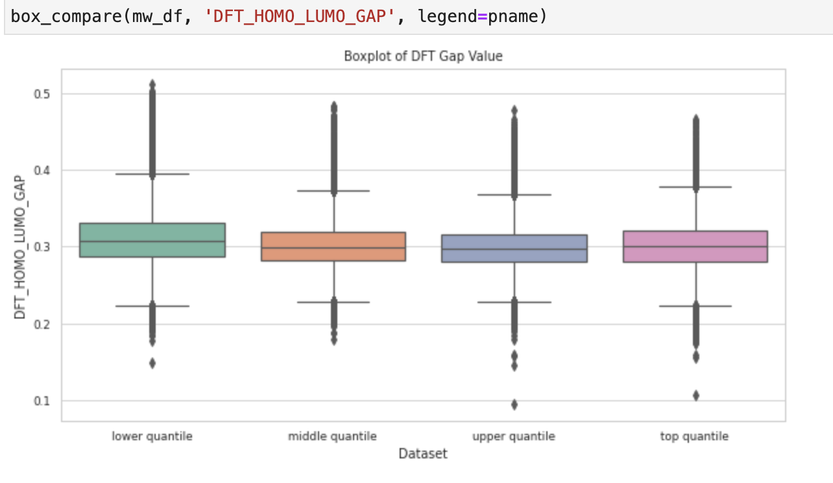
Step 2 : Explore DFT value in QMUGs
We want to see if we split the dataset based on the percentile of its ring, heavy atom, and mw, how DFT gap value will show a shift or change or not
Ring Count
Heavy Atoms
Molecular Weight
Higher percentile of its ring, heavy atom, and mw are associated with smaller DFT gap values, indicating a trend towards decreased DFT gap values with slight variation
Notes:
Explain why choose these ; pictures change?

Slide 23
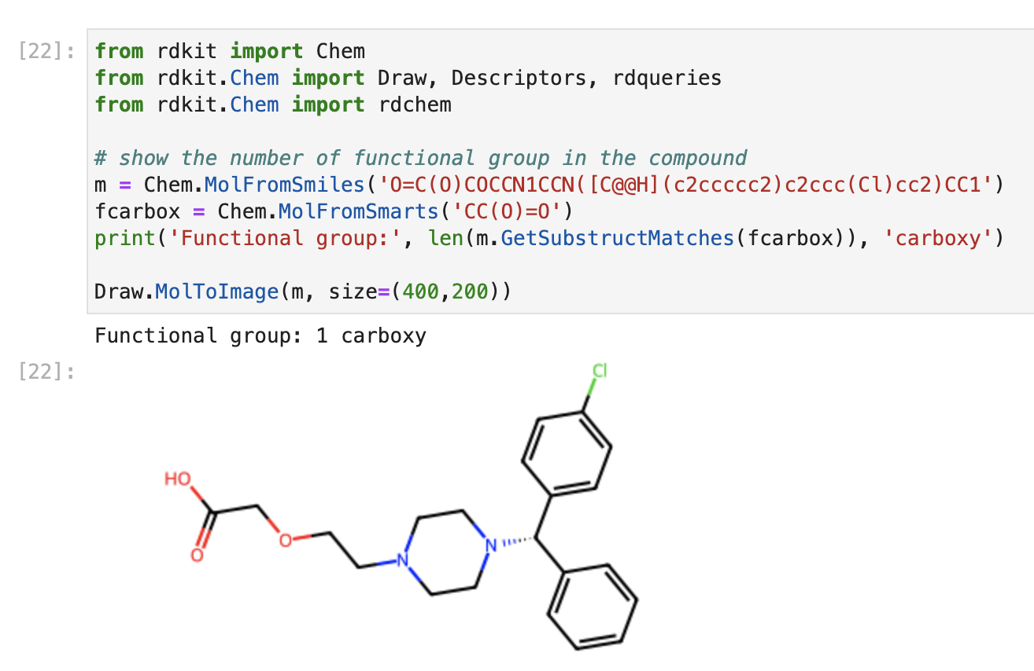
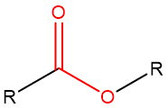
Step 2 : Visualize Functional Groups in Compounds
carboxy
carboxy

Slide 24
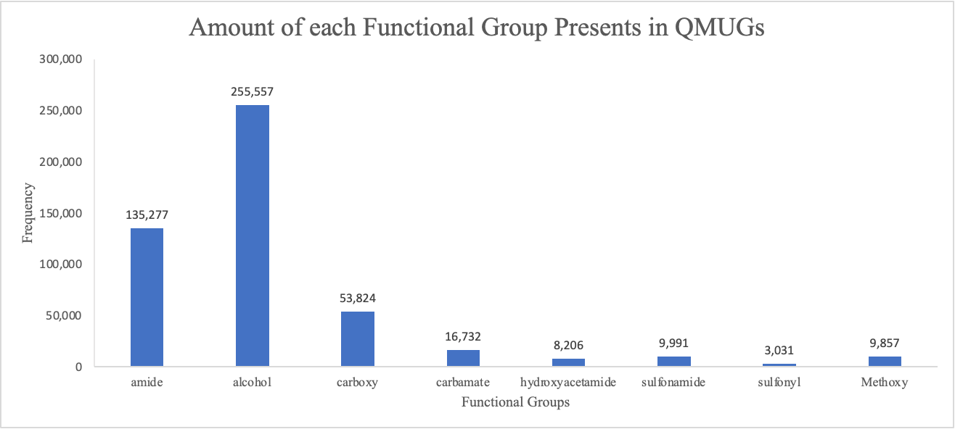
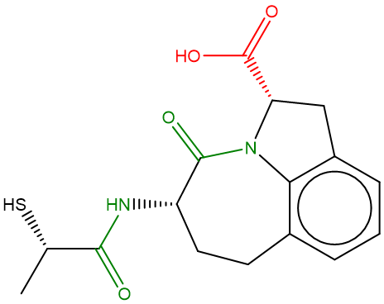
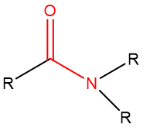
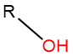
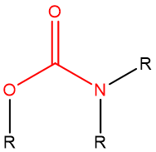
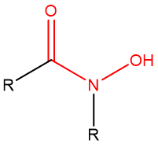
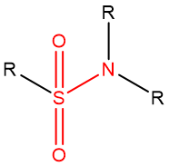
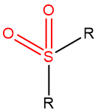
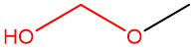
Step 2 : Explore Functional Groups in QMUGs
Number of functional groups present in QMUGs
amide | alcohol | carboxy | carbamate | hydroxyacetamide | sulfonamide | sulfonyl | Methoxy alcohol
135,277 | 255,557 | 53,824 | 16,732 | 8,206 | 9,991 | 3,031 | 9,857

Slide 25
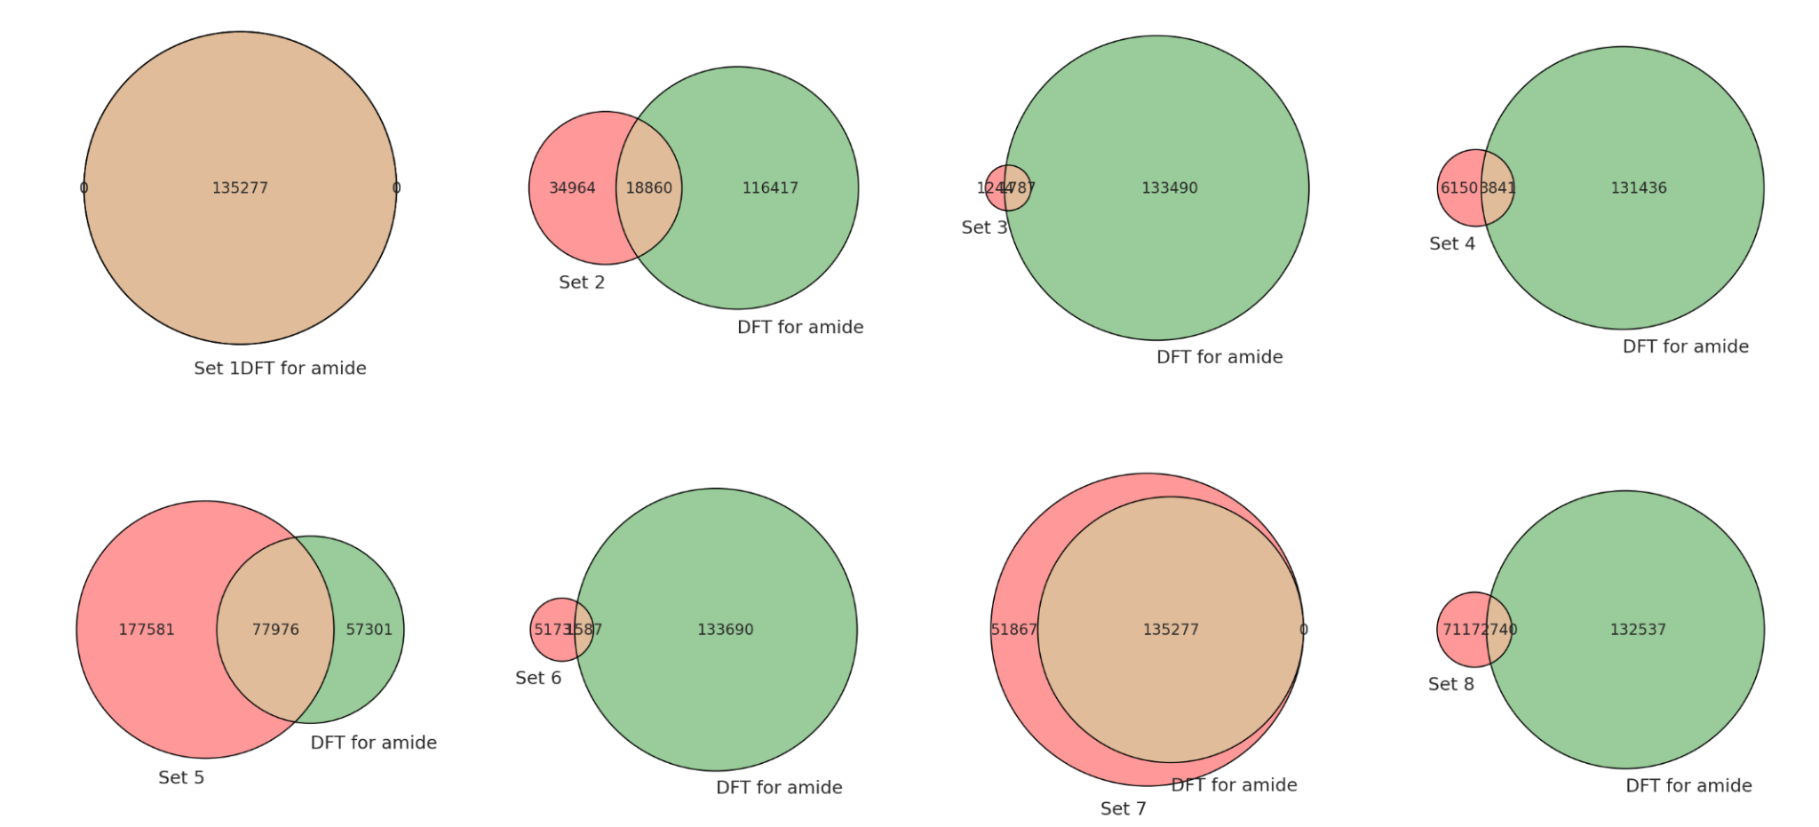
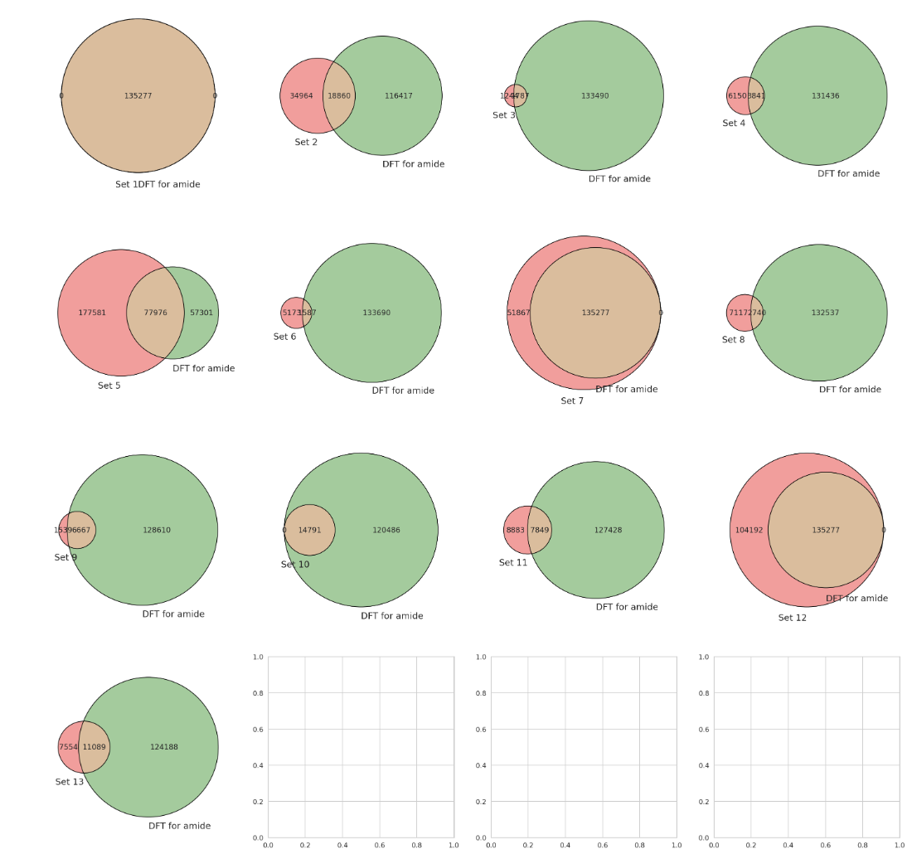
Step 2 : Explore Functional Groups in QMUGs
sulfonyl
sulfonamide
carboxy
amide
amide
amide
amide
carbamate
hydroxyacetamide
methoxyalcohol
amide
alcohol
amide
amide
amide
Notes:
There are compounds with overlaps of functional groups
Venn diagram for overlaps. Some of compounds may have multiple functional groups, which means that they might appear in different sub-dataset multiple times.
Reason: qmugs dataset is bigger, drugs might have multiple functional groups

Slide 26
Step 3
Model Training

Slide 27
Step 3: Model Training
Trained models based on different splitters and featurizers
Graph convolution featurizer has a better performance in models using random split and scaffold split.
ECFP featurizer has a lower performance in models using fingerprint split.
splitter | featurizer | training R^2 | validation R^2 | test R^2
random | graphconv | 0.923 | 0.899 | 0.898
scaffold | graphconv | 0.901 | 0.847 | 0.842
fingerprint | graphconv | 0.897 | 0.857 | 0.830
fingerprint | ecfp | 0.864 | 0.579 | 0.637
scaffold | ecfp | 0.903 | 0.772 | 0.747
random | ecfp | 0.889 | 0.851 | 0.851
Prediction Type:
Regression Models
Model Type: Neural Network

Slide 28
Step 4
Comparing Model Performance

Slide 29
Step 4 : Comparing Models based on Functional Groups
Random Split with graphconv featurizer yields the highest prediction accuracy among all models
Fingerprint Split with ecfp featurizer yields the lowest prediction accuracy among all models
splitter | featurizer | amide | alcohol | carboxy | carbamate | hydroxyacetamide | sulfonamide | sulfonyl | Methoxy alcohol
random | graphconv | 0.940 | 0.951 | 0.953 | 0.941 | 0.944 | 0.937 | 0.953 | 0.960
scaffold | graphconv | 0.879 | 0.883 | 0.888 | 0.877 | 0.879 | 0.869 | 0.886 | 0.899
fingerprint | graphconv | 0.911 | 0.924 | 0.908 | 0.901 | 0.903 | 0.899 | 0.928 | 0.926
fingerprint | ecfp | 0.750 | 0.775 | 0.681 | 0.703 | 0.751 | 0.782 | 0.773 | 0.656
scaffold | ecfp | 0.927 | 0.939 | 0.943 | 0.928 | 0.932 | 0.922 | 0.943 | 0.946
random | ecfp | 0.862 | 0.873 | 0.879 | 0.864 | 0.876 | 0.859 | 0.877 | 0.880

Slide 30
Step 4 : Comparing Models based on Functional Groups
Methoxyalcohol yields an overall higher prediction accuracy among all functional groups
Sulfonamide yields an overall lower prediction accuracy among all functional groups
splitter | featurizer | amide | alcohol | carboxy | carbamate | hydroxyacetamide | sulfonamide | sulfonyl | Methoxyalcohol
random | graphconv | 0.940 | 0.951 | 0.953 | 0.941 | 0.944 | 0.937 | 0.9525 | 0.960
scaffold | graphconv | 0.879 | 0.883 | 0.888 | 0.877 | 0.879 | 0.869 | 0.886 | 0.899
fingerprint | graphconv | 0.911 | 0.924 | 0.908 | 0.901 | 0.903 | 0.899 | 0.928 | 0.926
fingerprint | ecfp | 0.750 | 0.775 | 0.681 | 0.703 | 0.751 | 0.782 | 0.773 | 0.656
scaffold | ecfp | 0.927 | 0.939 | 0.943 | 0.928 | 0.932 | 0.922 | 0.943 | 0.946
random | ecfp | 0.862 | 0.873 | 0.879 | 0.864 | 0.876 | 0.859 | 0.877 | 0.880

Slide 31
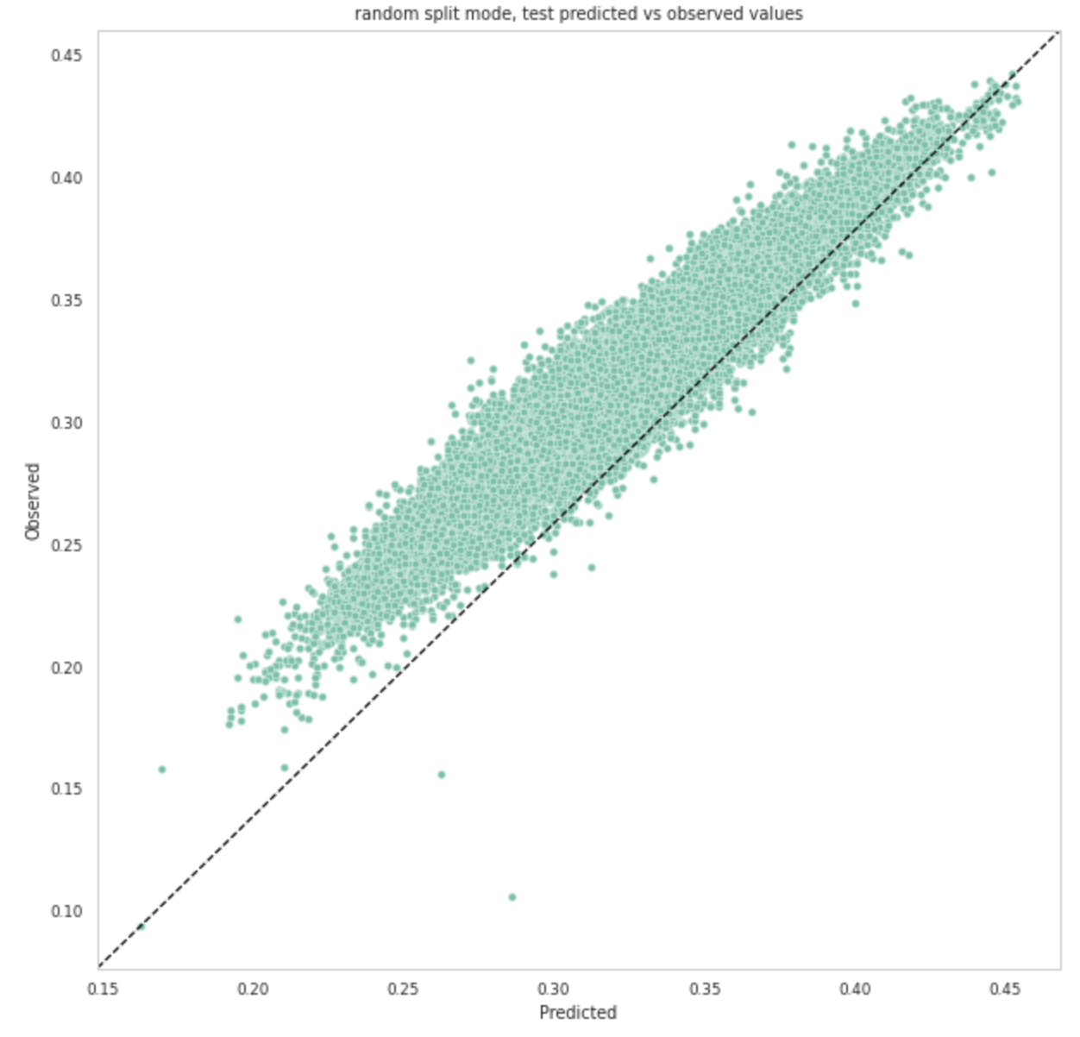
Step 4 : Comparing Models based on Functional Groups
Since the tested R^2 value is higher than 0.9, it is reasonable to observe that the data points perform a linear trend along the prediction line.

Slide 32
Conclusion

Slide 33
Model Comparison
The model uses Random Split model consistently demonstrates better performance in both training and testing stage, achieving higher prediction accuracy with both featurizer.
With graph convolution featurizer, the Random Split model and Scaffold Split model yield generally higher prediction accuracies on all functional groups. While the Fingerprint Split model has a better performance with ECFP featurizer.
Upon closer examination of predictive accuracy, we observed that the DFT gap value of functional group Methylalcohol could be predicted more accurately than others with our models.
Overall, although some groups produced higher R^2 values, the models were able to accurately predict the general range of compounds we explored with R^2 values 0.656 to 0.960.

Slide 34
Future Directions
Validate Model on External Dataset
Such as the Pereira, QM9, ANI-1x, or PubChem QC Data Sets
Predict other properties in the QMugs dataset
Integrate with a Generative Molecular Design (GMD) Model
To search for drug-like compounds with high or low HL-Gap values
Integrating HL Gap models with GMD have been successful
using the QM9 Dataset (smaller molecules)
using the JTVAE method (for HOMO values)

Slide 35
Reference

Slide 36
Reference
About Us. Atom. (n.d.). https://atomscience.org/welcome/#about-2-section
AMPL: A Data-Driven Modeling Pipeline for Drug Discovery Amanda J. Minnich, Kevin McLoughlin, Margaret Tse, Jason Deng, Andrew Weber, Neha Murad, Benjamin D. Madej, Bharath Ramsundar, Tom Rush, Stacie Calad-Thomson, Jim Brase, and Jonathan E. Allen Journal of Chemical Information and Modeling 2020 60 (4), 1955-1968 DOI: 10.1021/acs.jcim.9b01053
Isert, C., Atz, K., Jiménez-Luna, J. et al. QMugs, quantum mechanical properties of drug-like molecules. Sci Data 9, 273 (2022). https://doi.org/10.1038/s41597-022-01390-7
https://atomscience.org/
Ramakrishnan, R., Dral, P. O., Rupp, M., & von Lilienfeld, O. A. (2014). Quantum chemistry structures and properties of 134 kilo molecules. Scientific Data, 1(1). https://doi.org/10.1038/sdata.2014.22

Slide 37
Special Thanks
Michael Robbins - IEOR Professor
Justin Overhulse – FNL Mentor
Chloe Thangavelu – FNL Mentor
Becky Lein – ATOM Program Manager
Naomi Ohashi – ATOM Project Manager
Eric Stahlberg – FNL Cancer Data Science Initiative
Maggie Scully – FNL Partnership Development Office
Victoria Brun - FNL Partnership Development Office
Dwight Nissley – FNL Cancer Research Technology Program
Ethan Dmitrovsky – FNL CEO
ATOM Joint Research Committee

Slide 38
Q&A

Slide 39
Thank you for listening

